Slide 1
အားလုံးပဲ မင်္ဂလာပါ
Presentation by Lynn Myat Aung

Slide 2
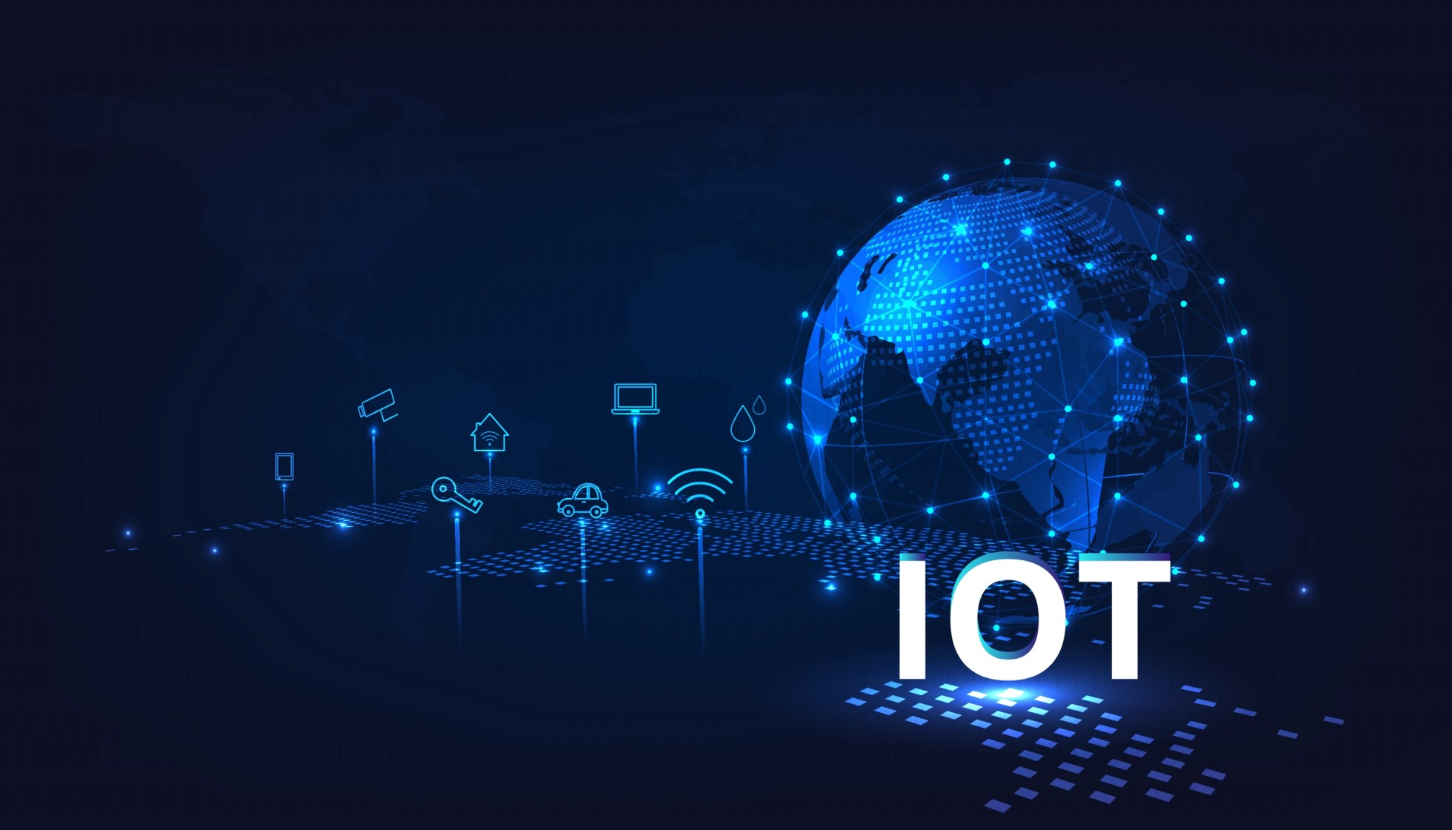
Smart Home Automation

Slide 3
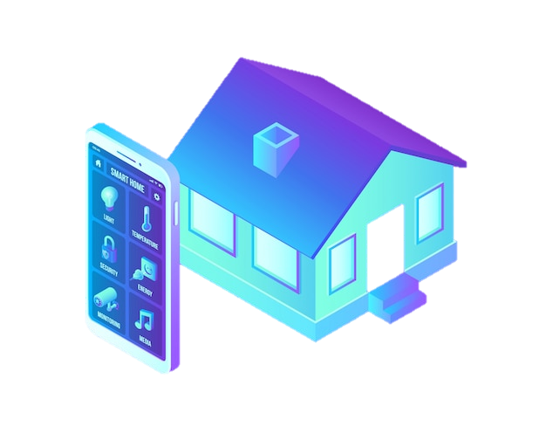
SMART HOME
Project Overview
Introduction to Smart Home Automation
What is IOT?
Why Smart Home are most adapted in nowadays?

Slide 4
SMART HOME
Project Overview
Introduction to Smart Home Automation
What is IOT?
Why Smart Home are most adapted in nowadays?

Slide 5
SMART HOME
Project Overview
Introduction to Smart Home Automation
Choosing the ESP32 for Microcontroller unit
All you need to know about Microcontroller
Esp32 Pinout
Project Requirements for smart home prototype
Circuit Design and workflow
Code analysis
Pros
What’s next?
Special Thanks
Duration – 1 hour

Slide 6
SMART HOME
Project Overview
Introduction to Smart Home Automation
Choosing the ESP32 for Microcontroller unit
All you need to know about Microcontroller
Esp32 Pinout
Project Requirements for smart home prototype
Circuit Design and workflow
Code analysis
Pros
What’s next?
Special Thanks
Ads
Duration – 1 hour

Slide 7
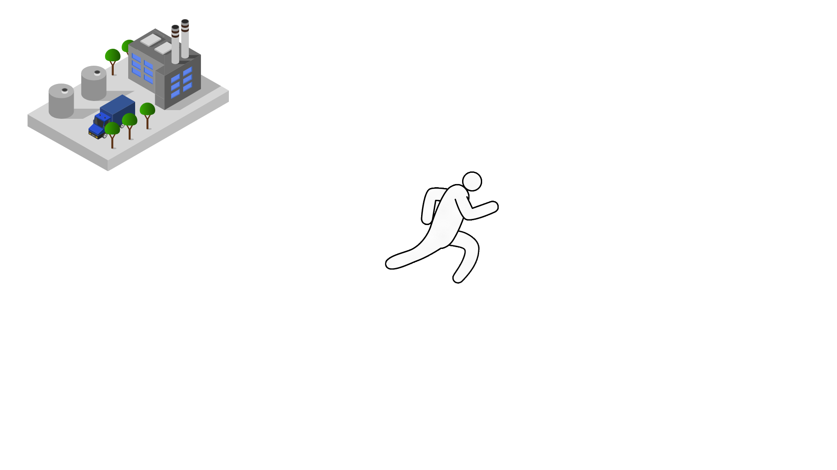

Project Overview
Introduction to Smart Home Automation
Choosing the ESP32 for Microcontroller unit
All you need to know about Microcontroller
Esp32 Architecture
Why we choice esp32?
Project Requirements for smart home prototype
Circuit Design and workflow
Code analysis
Pros
What’s next?
Special Thanks
Ads
Duration – 1 hour
SMART HOME
Smart Home automation

Slide 8
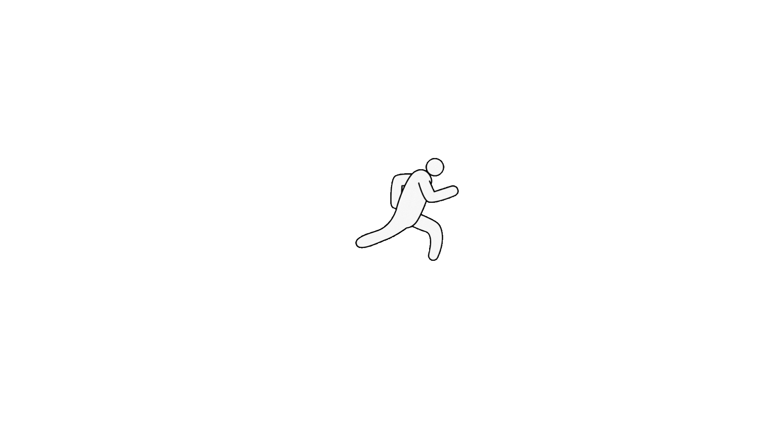
SMART HOME
Smart Home automation

Slide 9
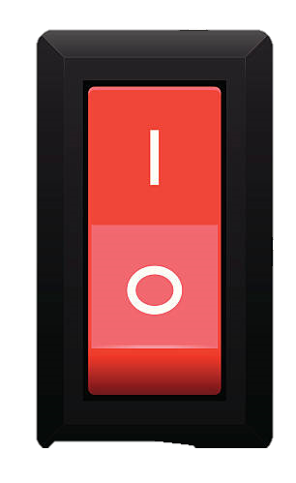
SMART HOME
Smart Home automation

Slide 10
SMART HOME
Smart Home automation

Slide 11
SMART HOME
Smart Home automation

Slide 12
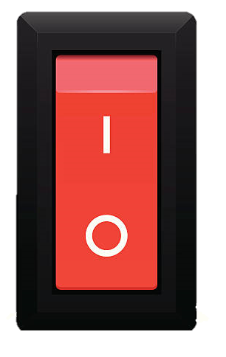
SMART HOME
Smart Home automation

Slide 13

SMART HOME
Smart Home automation

Slide 14
SMART HOME
Smart Home automation

Slide 15
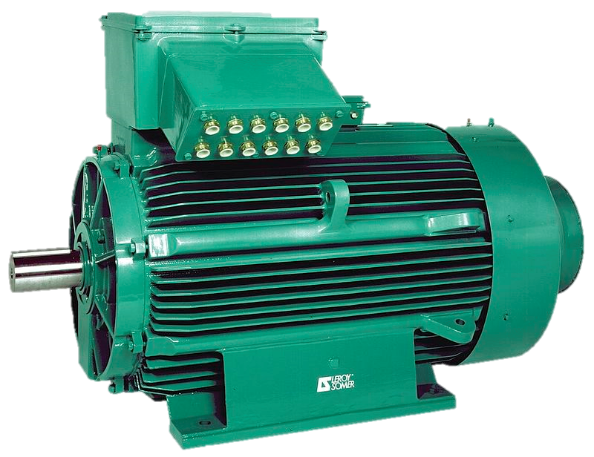

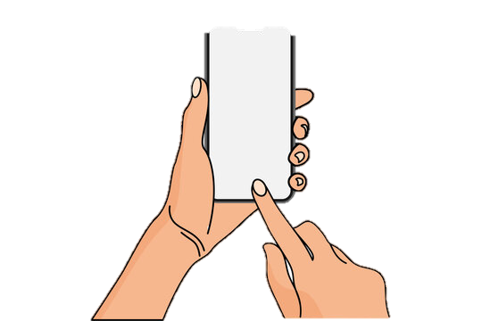
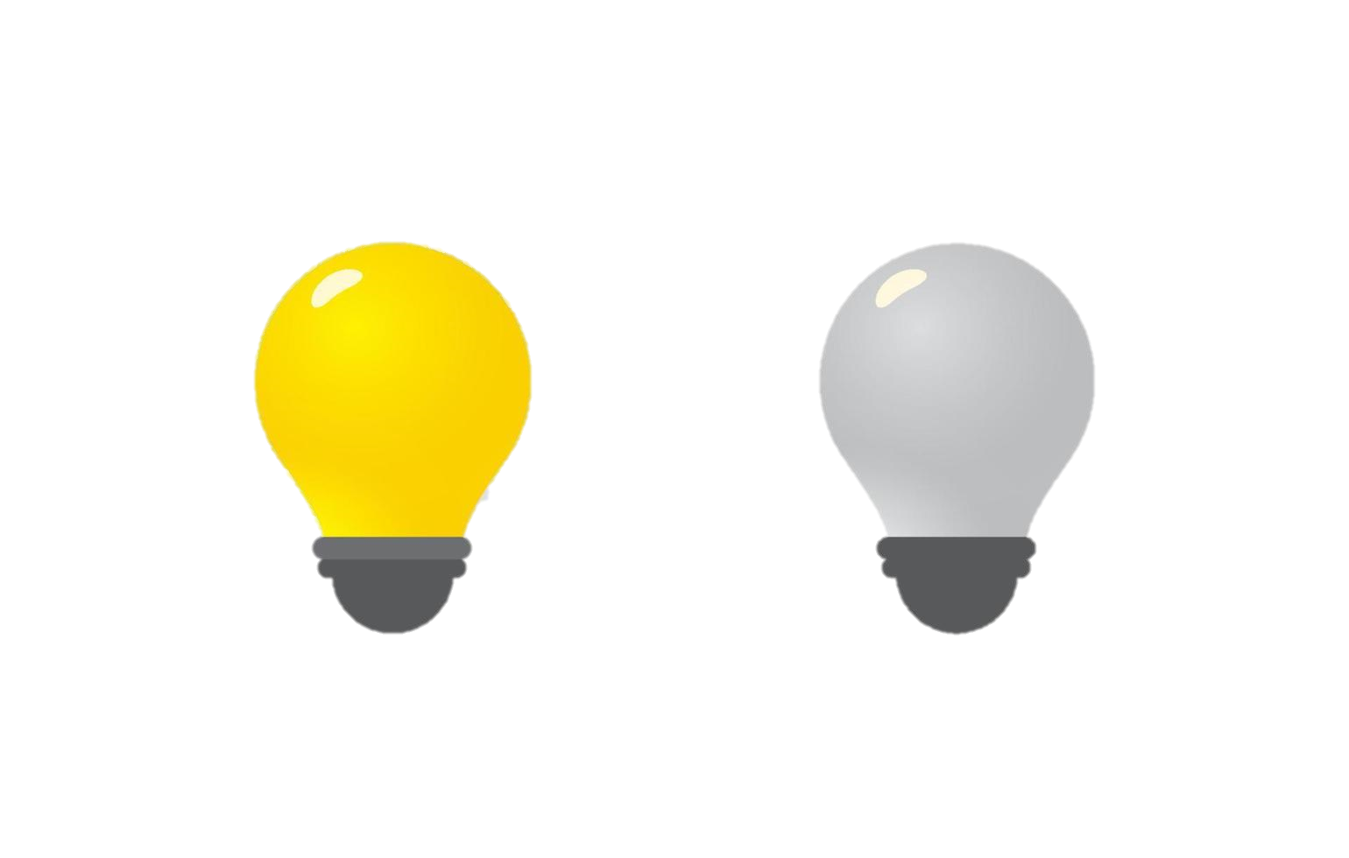
SMART HOME
Internet

Slide 16
SMART HOME
Internet

Slide 17
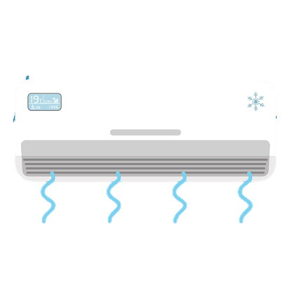

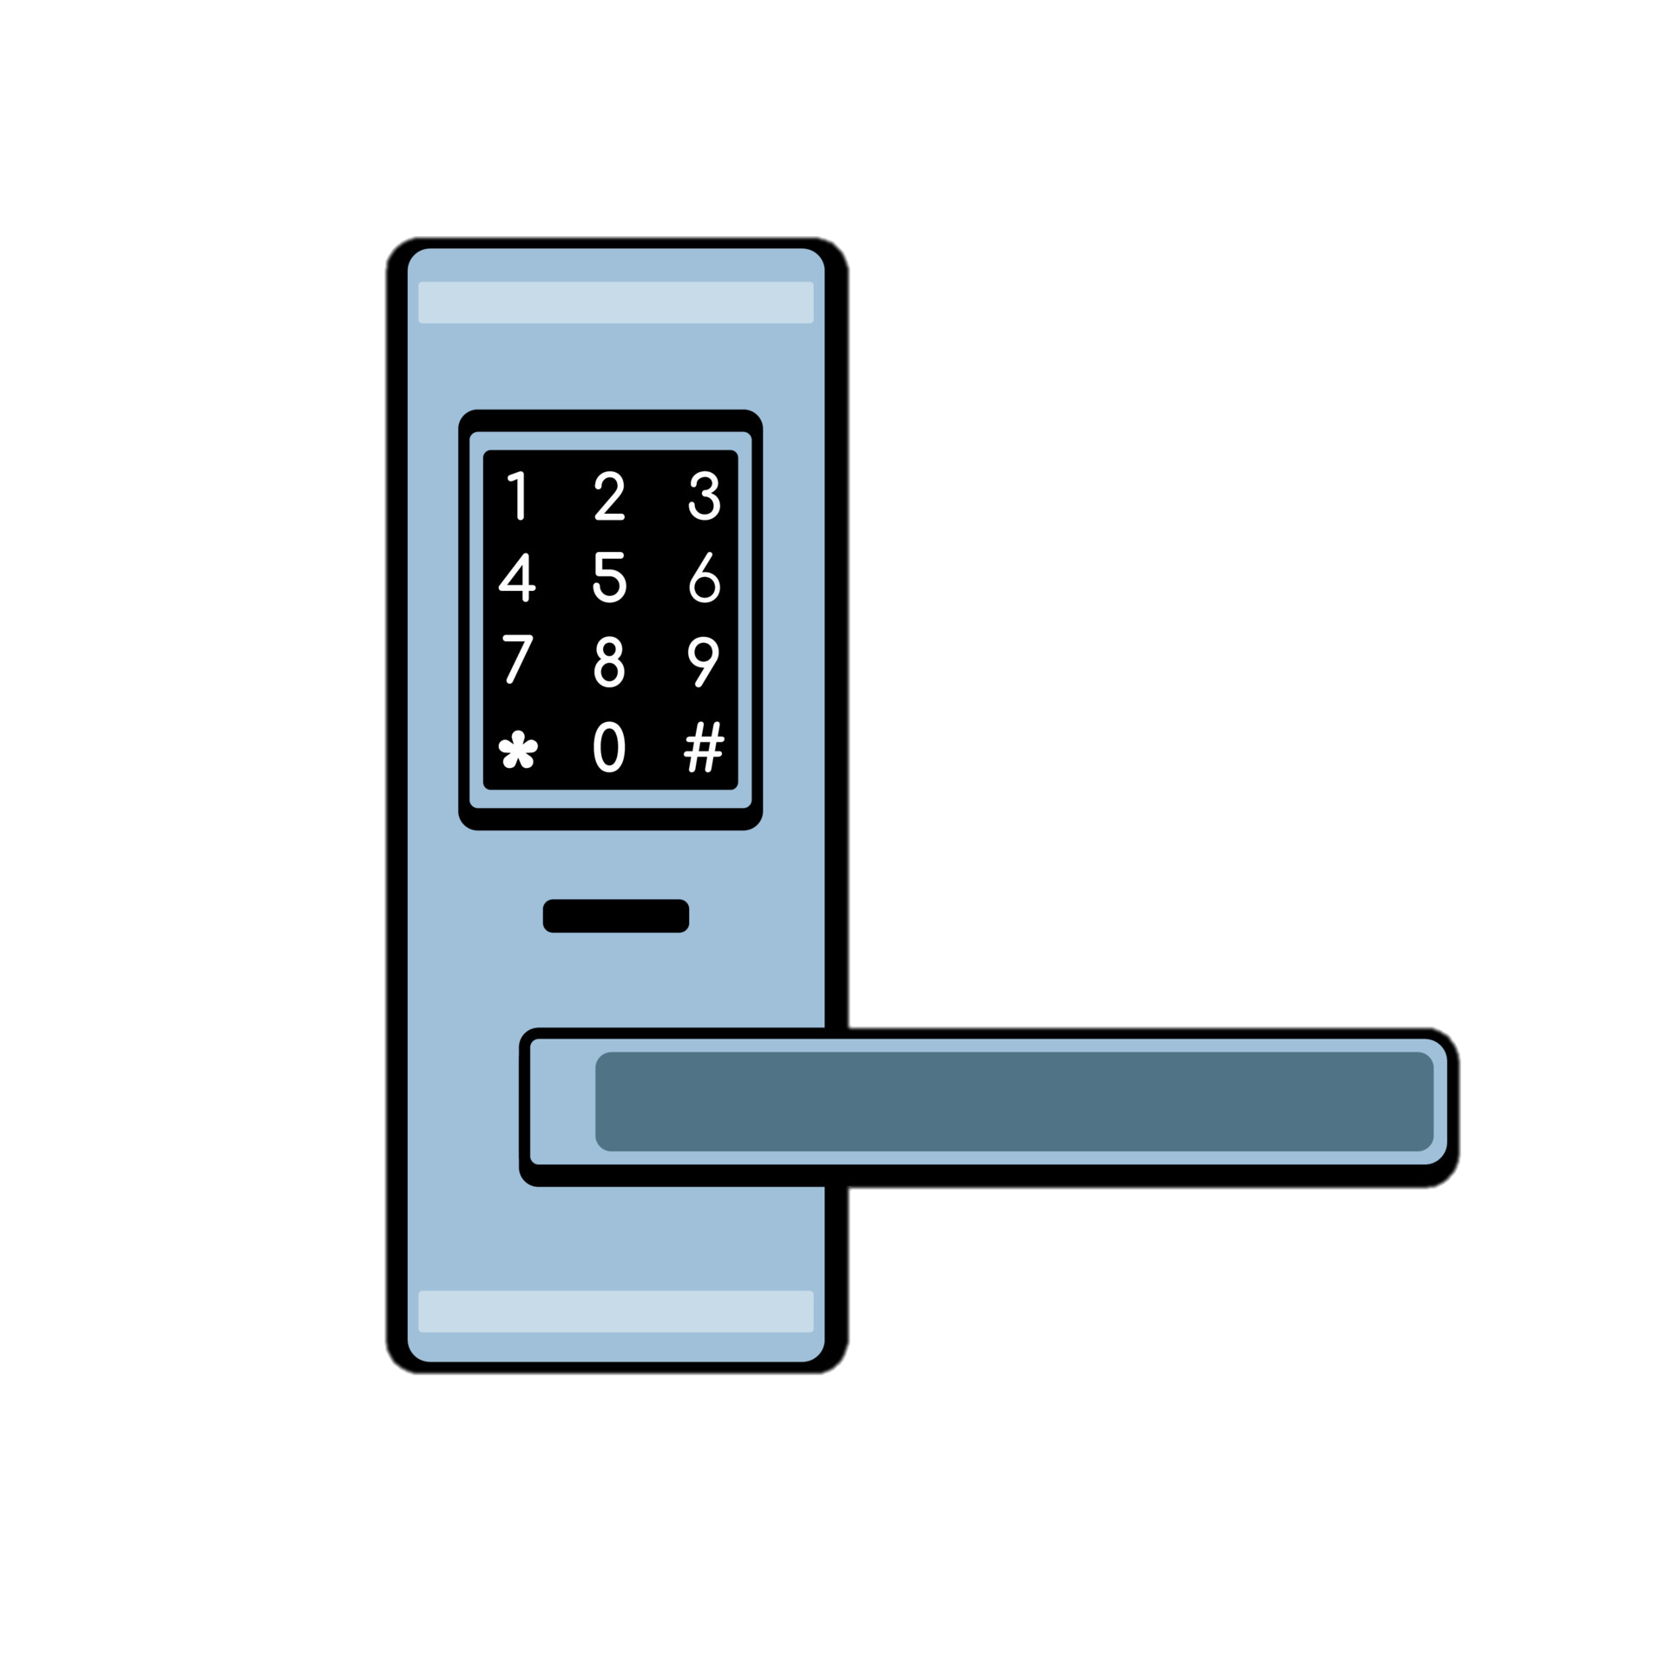
SMART HOME
Internet

Slide 18
SMART HOME
Smart Home automation
We can easily control to all home appliances with one system .
That ‘s why we called Smart Home Automation .
Smart Home Automation
is one of the most common field of I O T .

Slide 19
I
O
T

Slide 20
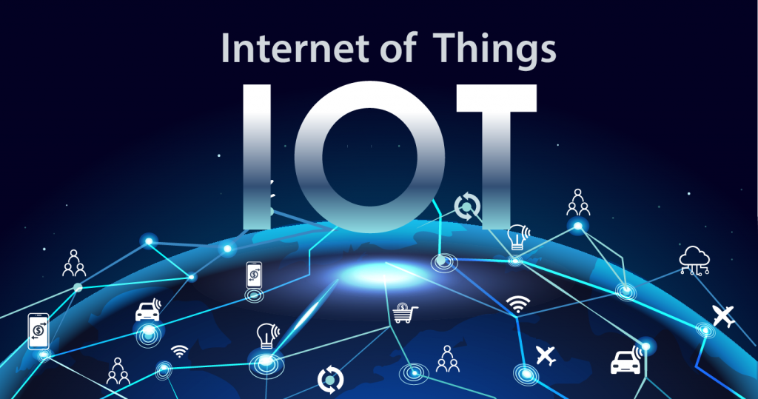
I
O
T
nternet
f
hings

Slide 21
I
O
T
nternet
f
hings

Slide 22
I
O
T
nternet
f
hings
Definition of IoT:
IoT refers to the network of physical devices, vehicles, home appliances, and other items embedded with electronics, software, sensors, actuators, and connectivity which enables them to connect and exchange data.

Slide 23
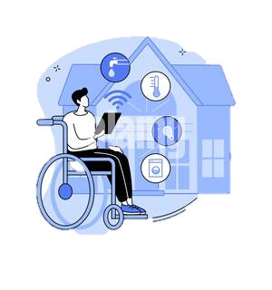


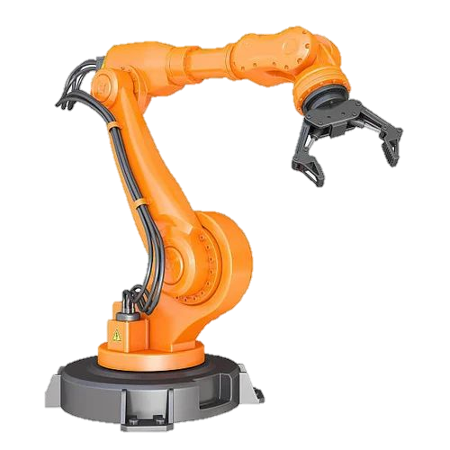
The major filed of IOT are used in
I O T

Slide 24


Health Care
IOT based application are used in health monitoring .
A lot of health detecting sensor can find in smart watch
Health monitoring is the one of the best to record the patient data in every minute .
I O T

Slide 25
I O T

Slide 26
I O T

Slide 27
I O T

Slide 28
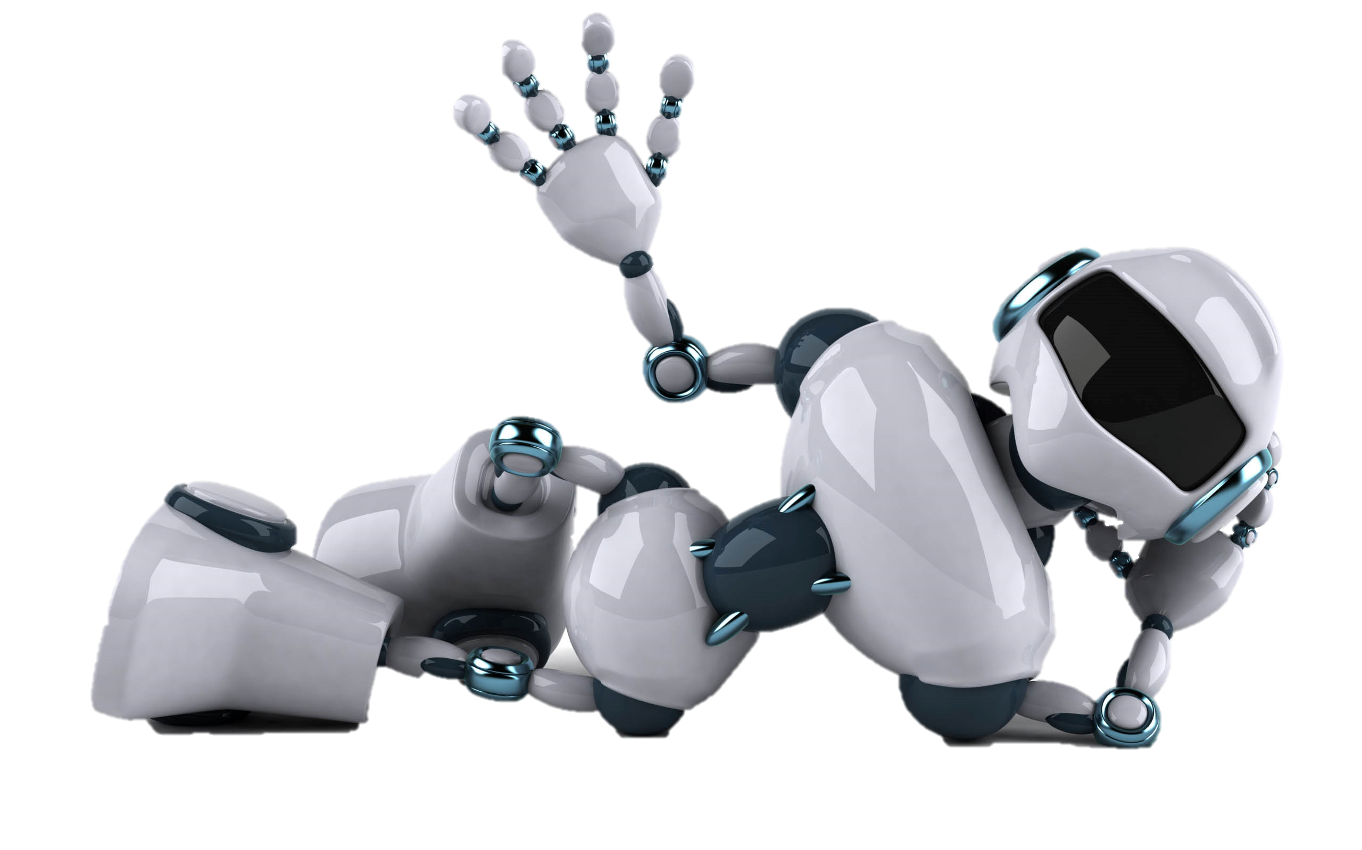
Robotic
Easily to integrate for robotic , ranging from optimizing production processes and enhancing efficiency to facilitating remote monitoring and assistance.
I O T

Slide 29
I O T

Slide 30
I O T

Slide 31
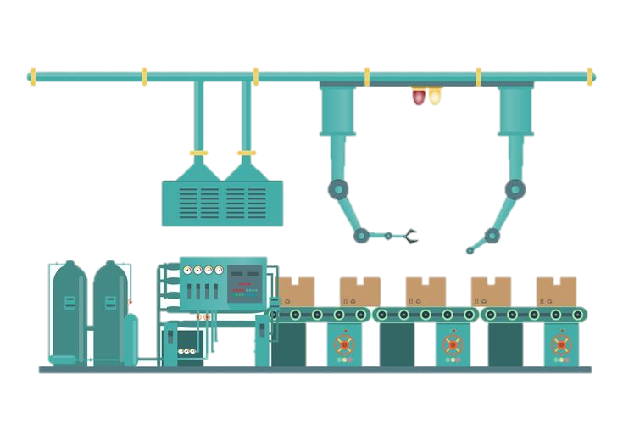
Manufacturing Industry
We can control machine using IOT device . Easy monitoring and Low-cost development make to reduce of workforce . Easy to monitor the system with computer and smart phone
I O T

Slide 32
I O T

Slide 33
I O T

Slide 34
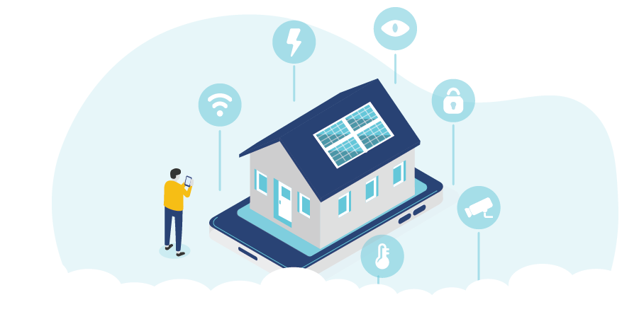
Smart Home Automation
Easy can control to Household Appliances over network
I O T

Slide 35
I O T

Slide 36
Section - 2
Choosing the Microcontroller

Slide 37
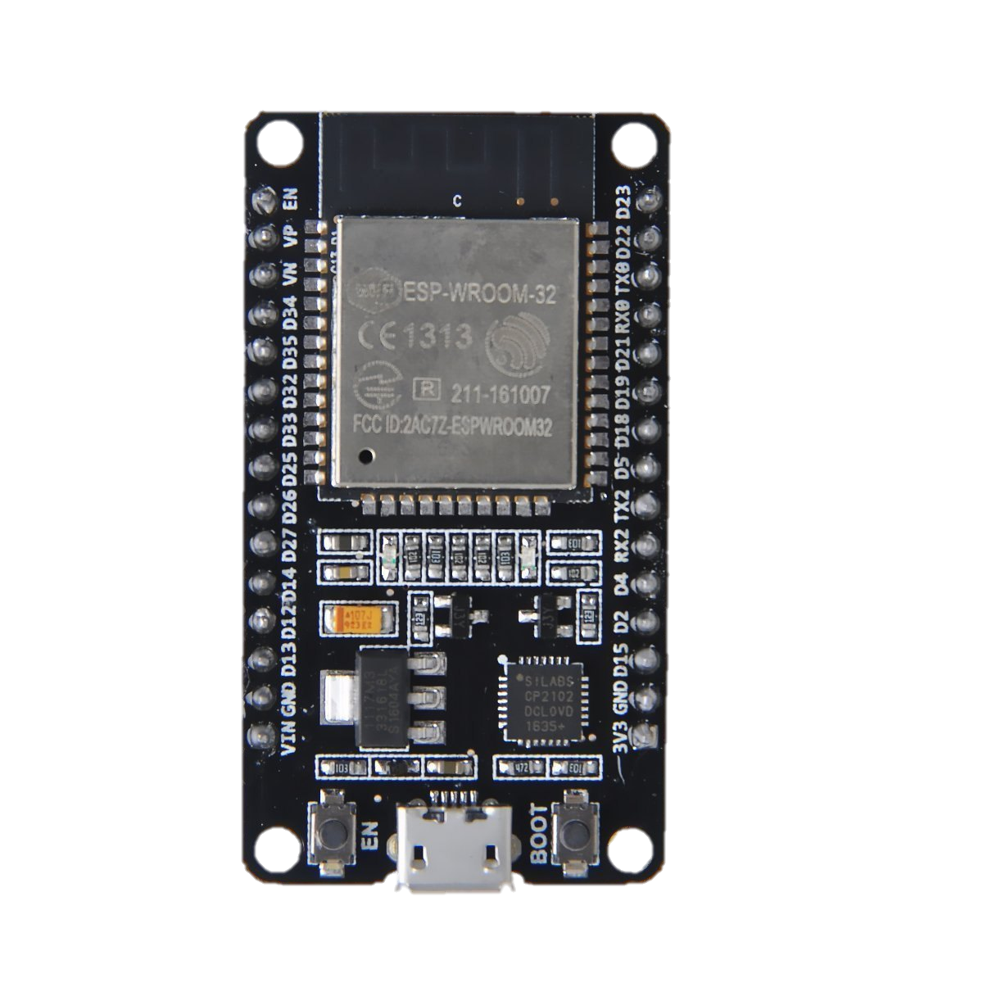
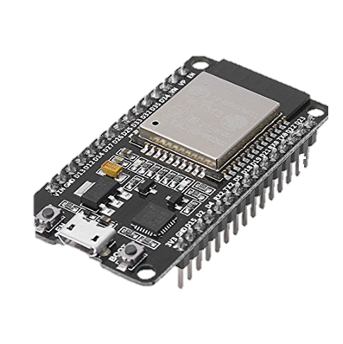
We are choosing ESP32 for design implementing on this project.
The most familiar MCU among student is ESP32
Easy to used
Affordable price
Support Wireless
It’s clock speed ( 80 Hz to 240 Hz)
You can read data sheet and easy to implement this
Project if you are familiar with MCU.

Slide 38
Section - 3
How Microcontroller work

Slide 39
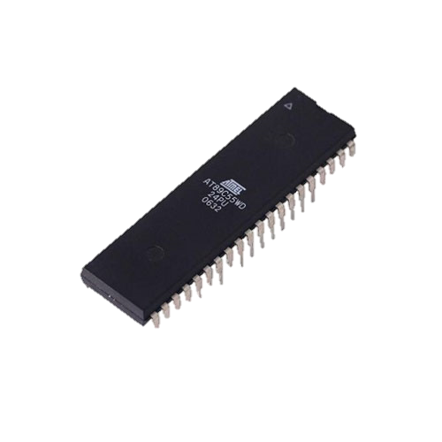
What is Microcontroller?
A microcontroller (MCU) is a small computer on a single integrated circuit that is designed to control specific tasks within electronic systems. It combines the functions of a central processing unit (CPU), memory, and input/output interfaces, all on a single chip.

Slide 40
Microcontroller
: how they operate
Memory
Control Unit
Arithmetic & Logic Unit(ALU)
Central Processing Unit
Input
Output

Slide 41
Volatile
Non-Volatile
Temporary store the data
E.g. RAM
Bootup file , firmware , program ,
E.g. SSD, HDD , CD , ROM
Memory
Control Unit
Arithmetic & Logic Unit(ALU)
Timer / Counter
Central Processing Unit
Bus Control
Input
Output

Slide 42
Volatile
Non-Volatile
Memory
Control Unit
Arithmetic & Logic Unit(ALU)
Timer / Counter
Central Processing Unit
Bus Control
Input
Output

Slide 43
Volatile
Non-Volatile
Memory
Control Unit
Arithmetic & Logic Unit(ALU)
Timer / Counter
Central Processing Unit
Bus Control
Input
Output

Slide 44
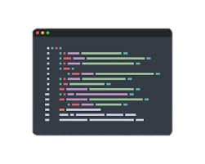
Volatile
Non-Volatile
Memory
Control Unit
Arithmetic & Logic Unit(ALU)
Timer / Counter
Central Processing Unit
Bus Control
Input
Output

Slide 45
CPU (Central Processing Unit): CPU act as a mind of any processing machine. It synchronizes and manages all processes that are carried out in microcontroller. User has no power to control the functioning of CPU. It interprets the program stored in ROM and carries out from storage and then performs it projected duty. CPU manage the different types of registers available in microcontroller.
Interrupts: Interrupts is a sub-routine call that given by the microcontroller when some other program with high priority is request for acquiring the system buses the n interrupts occur in current running program. Interrupts provide a method to postpone or delay the current process, performs a sub-routine task and then restart the standard program again

Slide 46
Memory: For operation Micro-controller required a program. This program guides the microcontroller to perform the specific tasks. This program installed in microcontroller required some on chip memory for the storage of the program.
Bus : Bus is a group of wires which uses as a communication canal or acts as means of data transfer. The different bus configuration includes 8, 16 or more cables. Therefore, a bus can bear 8 bits, 16 bits all together.
Address Bus: 8051 microcontrollers is consisting of 16 bit address bus. It is generally be used for transferring the data from Central Processing Unit to Memory.
Data bus: 8051 microcontroller is consisting of 8 bits data bus. It is generally be used for transferring the data from one peripherals position to other peripherals.

Slide 47
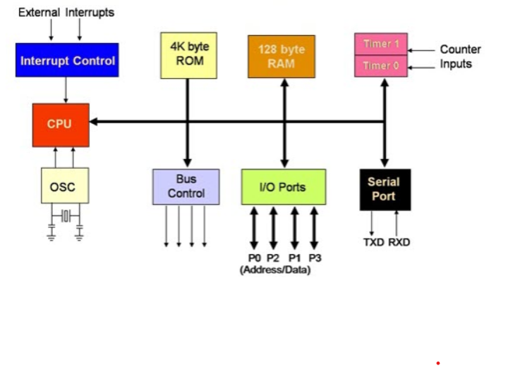

Slide 48
SMART HOME
Esp. 32 Pin number

Slide 49
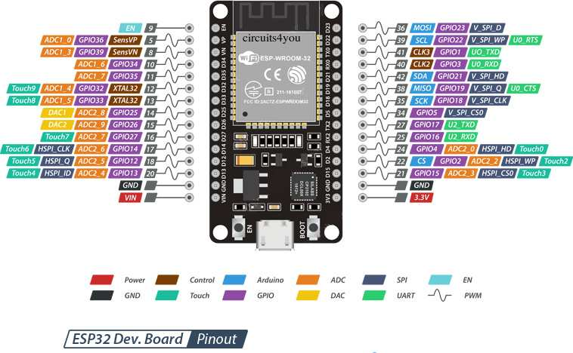
SMART HOME

Slide 50
SMART HOME
Project Requirements

Slide 51
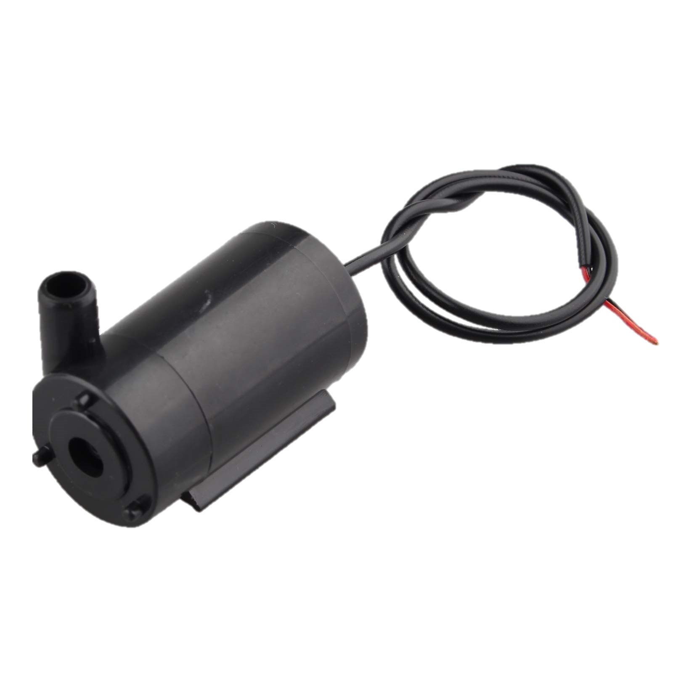
SMART HOME
Project Requirements
ESP32 w-room

Slide 52
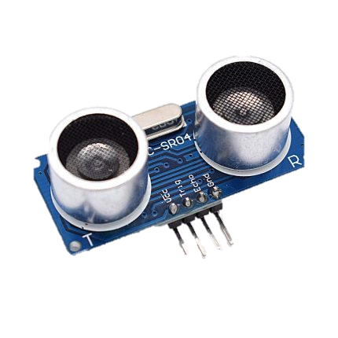
SMART HOME
Project Requirements
ESP32 w-room
9V water pump

Slide 53
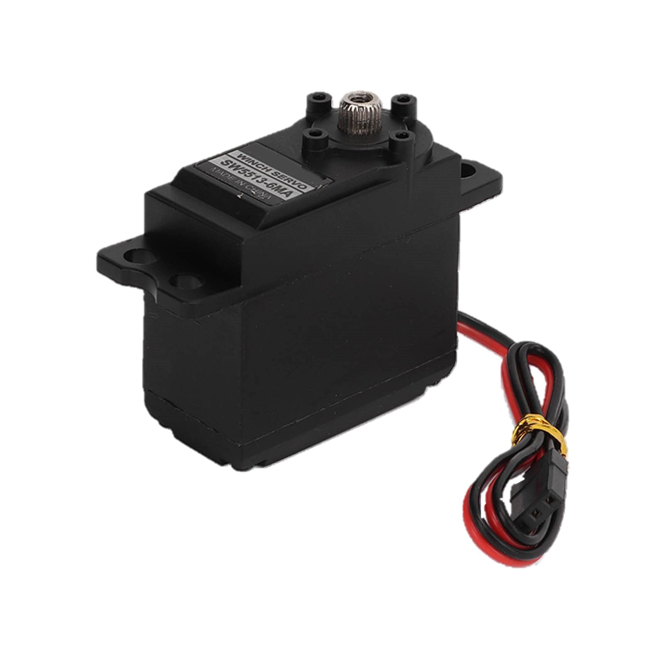
SMART HOME
Project Requirements
ESP32 w-room
9V water pump
Ultrasonic Sensor

Slide 54
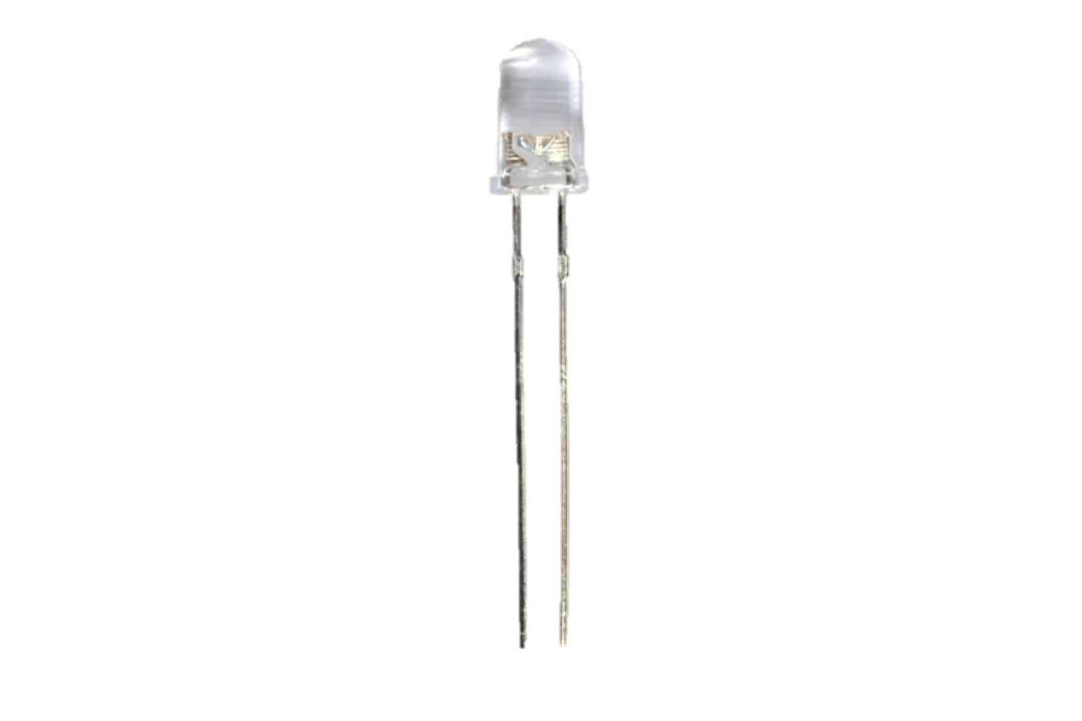
SMART HOME
Project Requirements
ESP32 w-room
9V water pump
Ultrasonic Sensor
Servo Motor

Slide 55
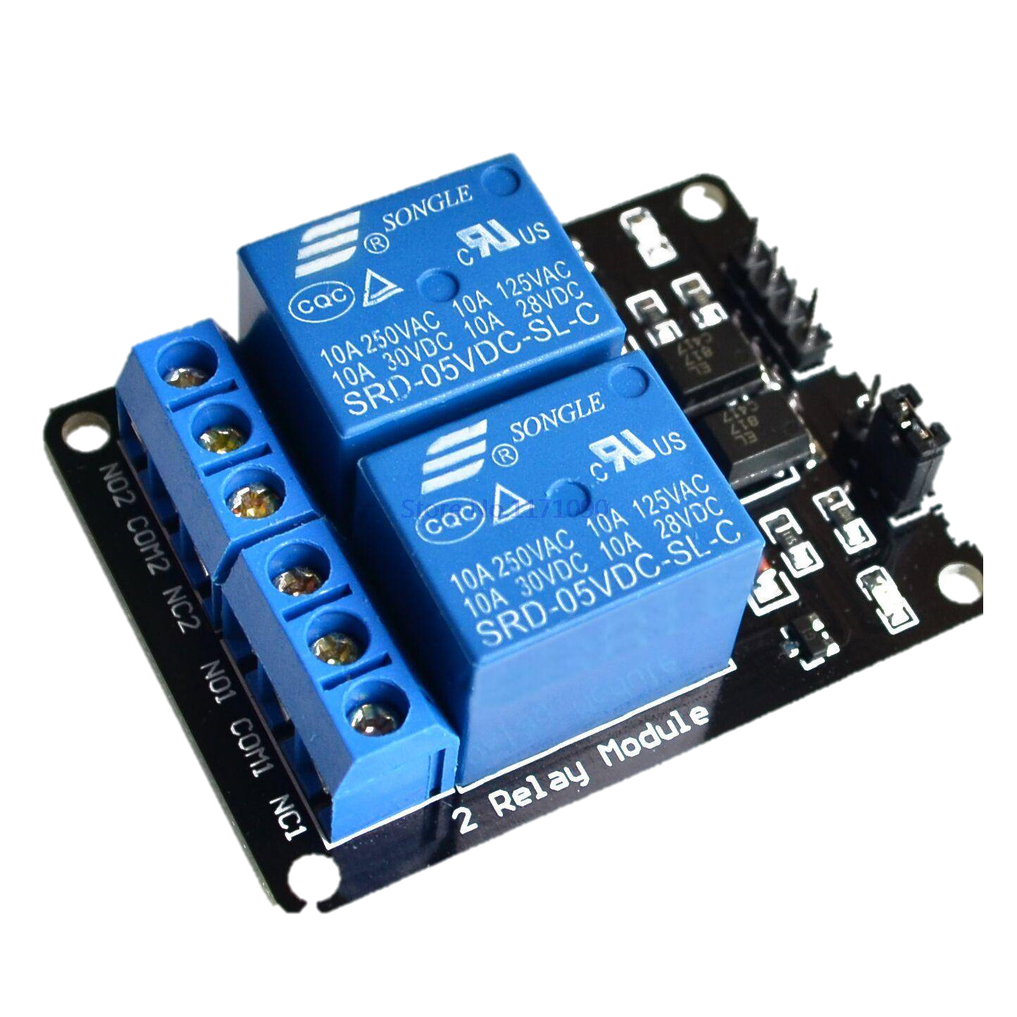
SMART HOME
Project Requirements
ESP32 w-room
9V water pump
Ultrasonic Sensor
Servo Motor
LEDs

Slide 56

SMART HOME
Project Requirements
ESP32 w-room
9V water pump
Ultrasonic Sensor
Servo Motor
LEDs
2 channel relay

Slide 57
SMART HOME
Project Requirements
ESP32 w-room
9V water pump
Ultrasonic Sensor
Servo Motor
LEDs
2 channel relay
9V battery x 2

Slide 58
SMART HOME
Circuit Diagram

Slide 59
SMART HOME

Slide 60
SMART HOME
Flow Chart of this project

Slide 61
Pros of this project
Showing how we are understanding MCU
Project management skill
How IOT are worked
About soldering
Real time Circuit analysis
Soft Skill with team
SMART HOME
if client connect to web server
start
give client to Landing Page
inactive or
active
Door Open
State = active
active
Door Button
Door close
State = active
inactive
Inactive or active
LED Open
State = active
active
Led Button
LED Close
State = inactive
inactive
Ultrasonic sensor check
Inactive or active
Water pump
State = active
active
Water Pump
Water pump
State = inactive
inactive

Slide 62
SMART HOME
Pros of this project
Showing how we are understanding MCU
Project management skill
How IOT are worked
About soldering
Real time Circuit analysis
Soft Skill with team

Slide 63

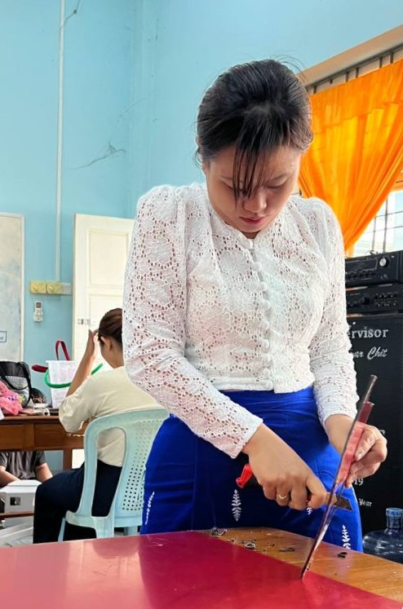
SMART HOME
Special Thanks to
our Head office Teacher Daw Hay Mar Maung
to held this project

Slide 64
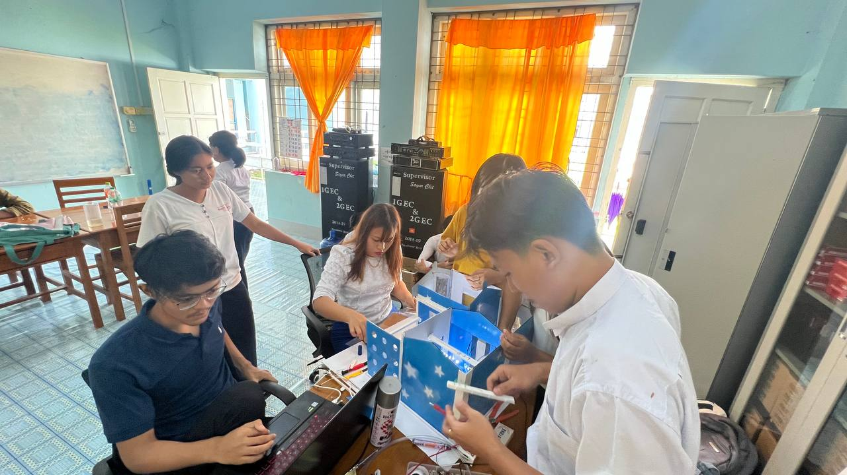
SMART HOME
Special Thanks to
our Supervisor Teacher Daw Ngu War Naing
To manage this project

Slide 65
SMART HOME
Thanks to
All contributors
on this project

Slide 66
Pros of this project
Showing how we are understanding MCU
Project management skill
How IOT are worked
About soldering
Soft Skill with team
SMART HOME
Thanks to all teacher

Slide 67
SMART HOME
Our Team
Mg Lynn Myat Aung
Mg Aung Kaung Myat
Mg Kaung Myat Min
Mg Zin Htet
Mg Naing Lin Tun
Ma Nandar Aung
Ma Pwint Phyo Thu
Ma Aye Chan Moe
Ma Saw Yu Nwe
- Project Lead

Slide 68
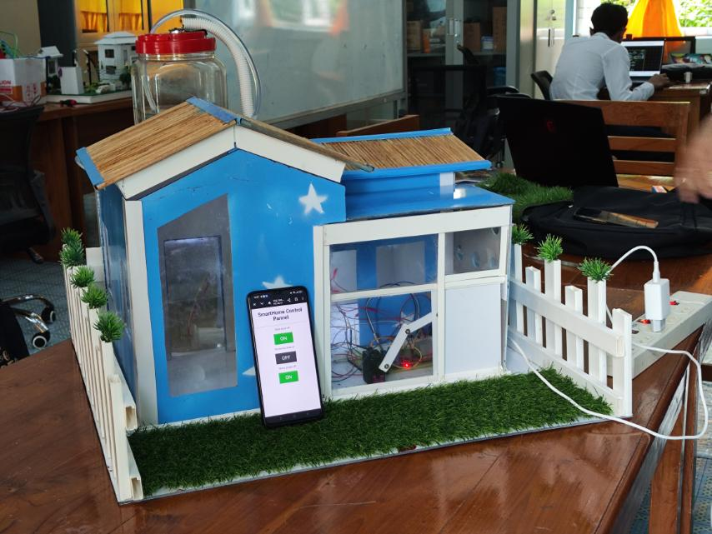
Pros of this project
Showing how we are understanding MCU
Project management skill
How IOT are worked
About soldering
Soft Skill with team
SMART HOME

Slide 69
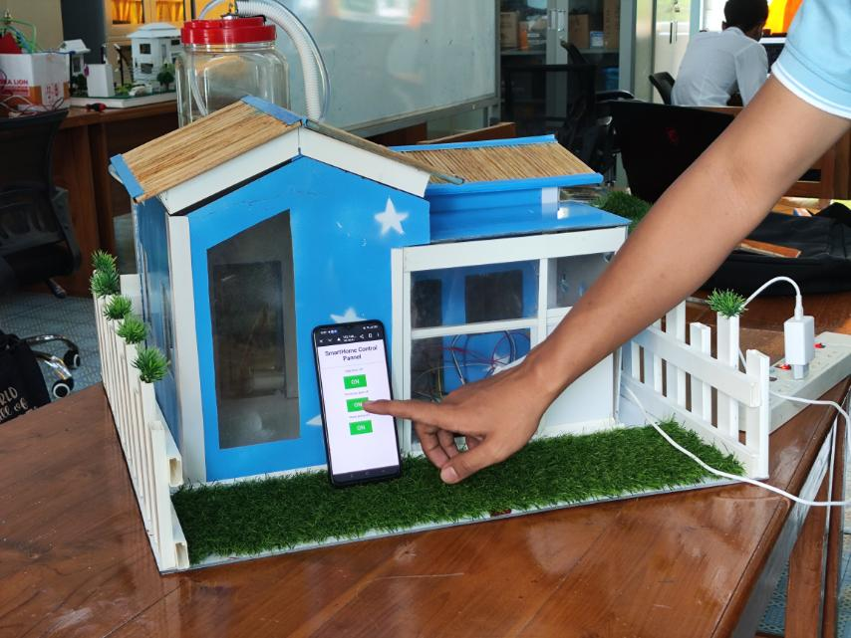
Pros of this project
Showing how we are understanding MCU
Project management skill
How IOT are worked
About soldering
Soft Skill with team
SMART HOME

Slide 70
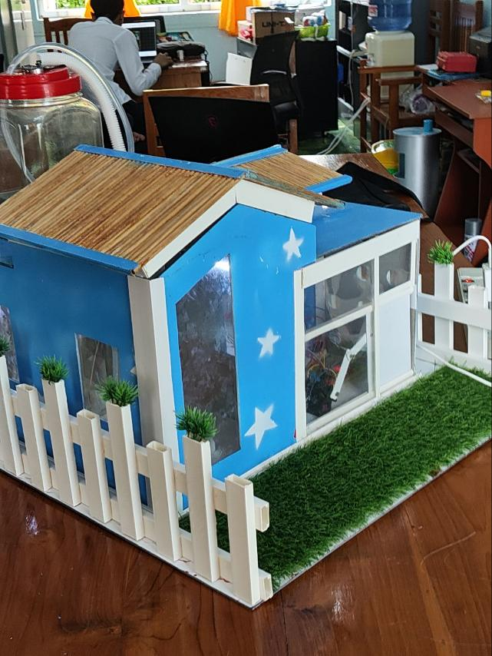
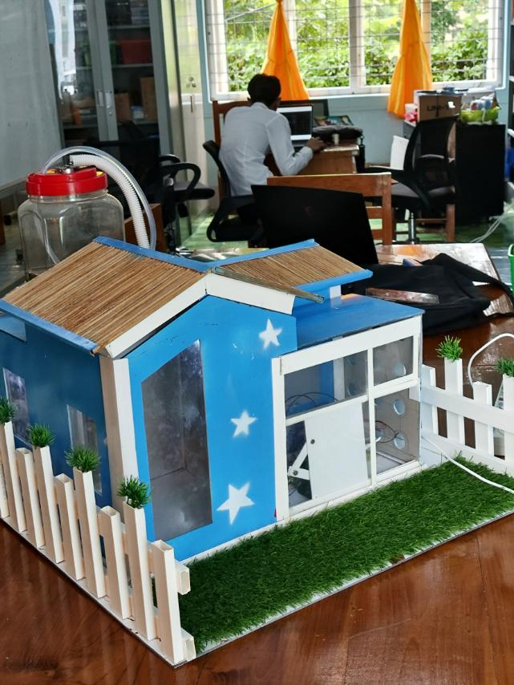
Pros of this project
Showing how we are understanding MCU
Project management skill
How IOT are worked
About soldering
Soft Skill with team
SMART HOME

Slide 71
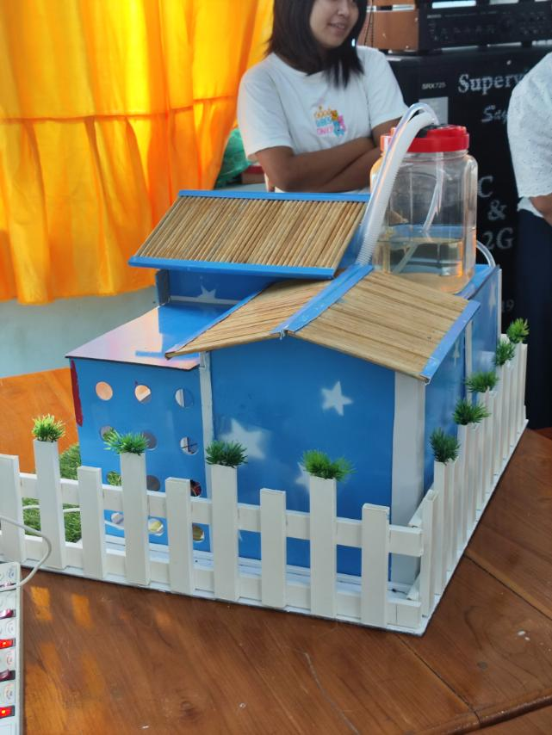
Pros of this project
Showing how we are understanding MCU
Project management skill
How IOT are worked
About soldering
Soft Skill with team
SMART HOME

Slide 72
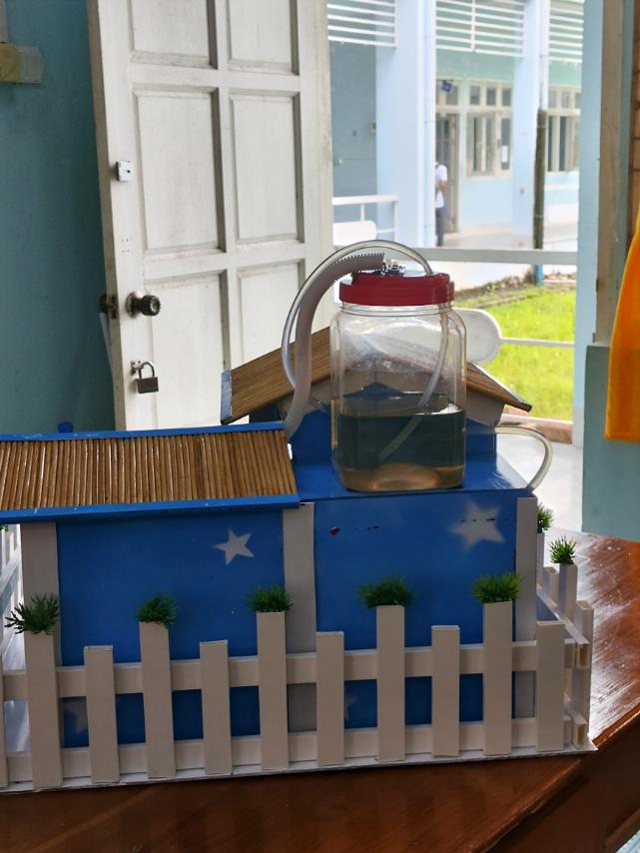
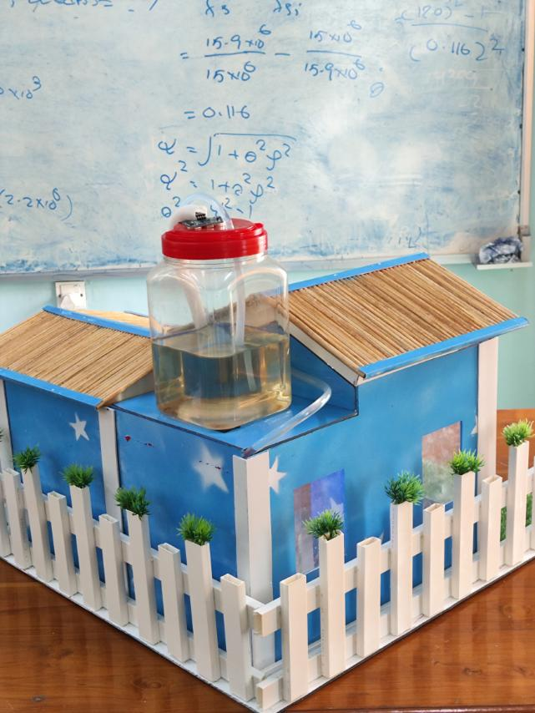
SMART HOME

Slide 73
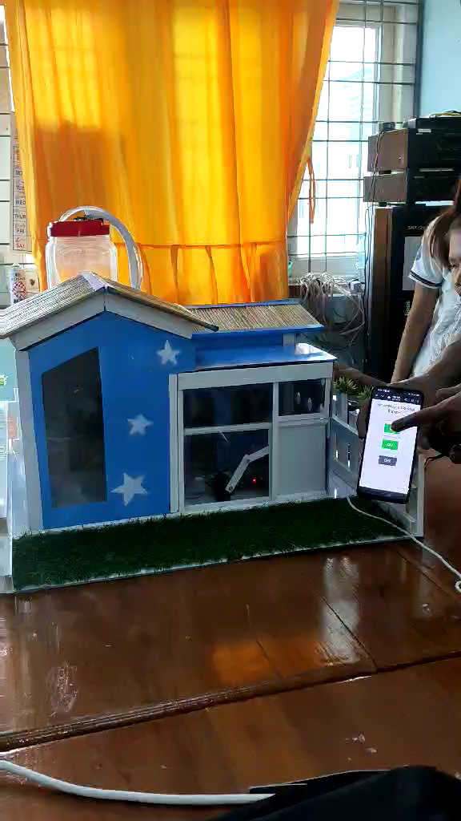
SMART HOME

Slide 74
Pros of this project
Showing how we are understanding MCU
Project management skill
How IOT are worked
About soldering
Soft Skill with team
SMART HOME
Thanks for your attention

